Slide 1
OEM Update Ken Hedgecock- VP, Sales, Marketing and Service

Slide 2
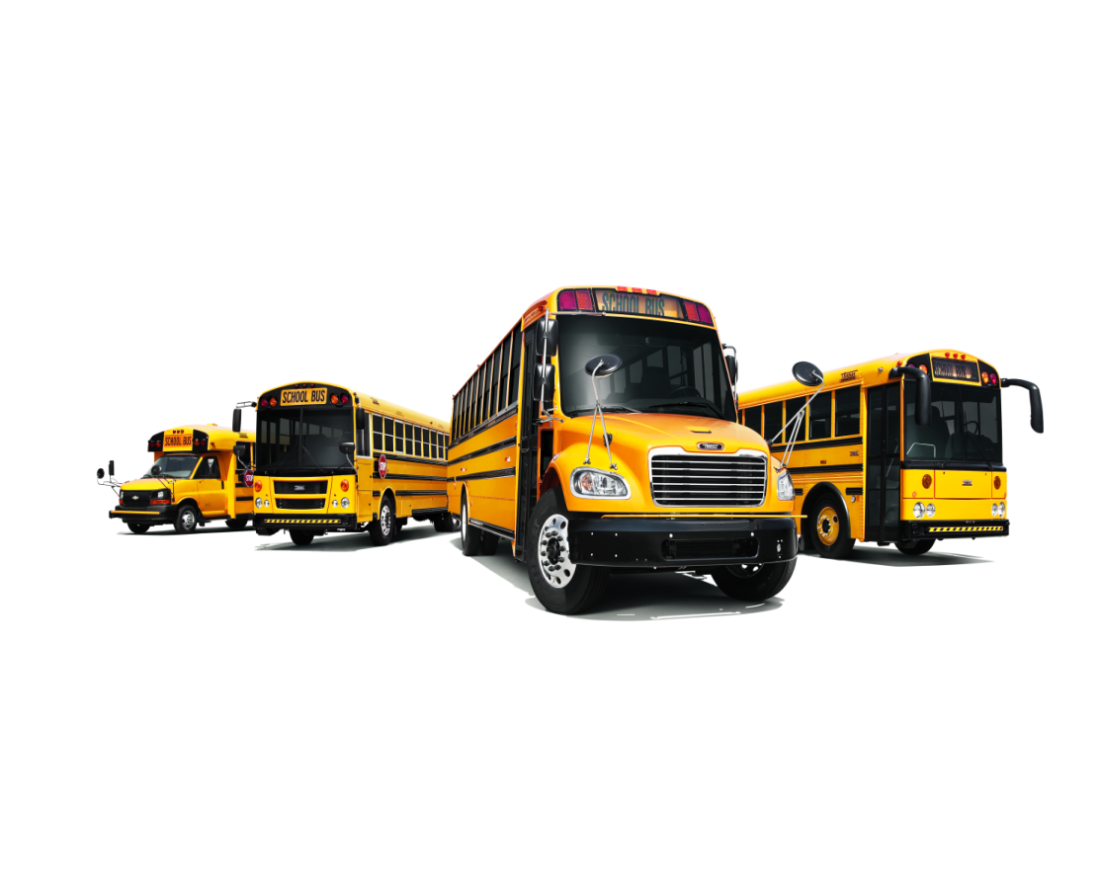
Market Overview
DD5 Update
BusWise Update
GHG 2021

Slide 3
Type C&D market forecasted to grow to pre-recession levels by ‘18
36,682
34,854
34,009
32,438
32,880
Type C
Type D
Total Market

Slide 4
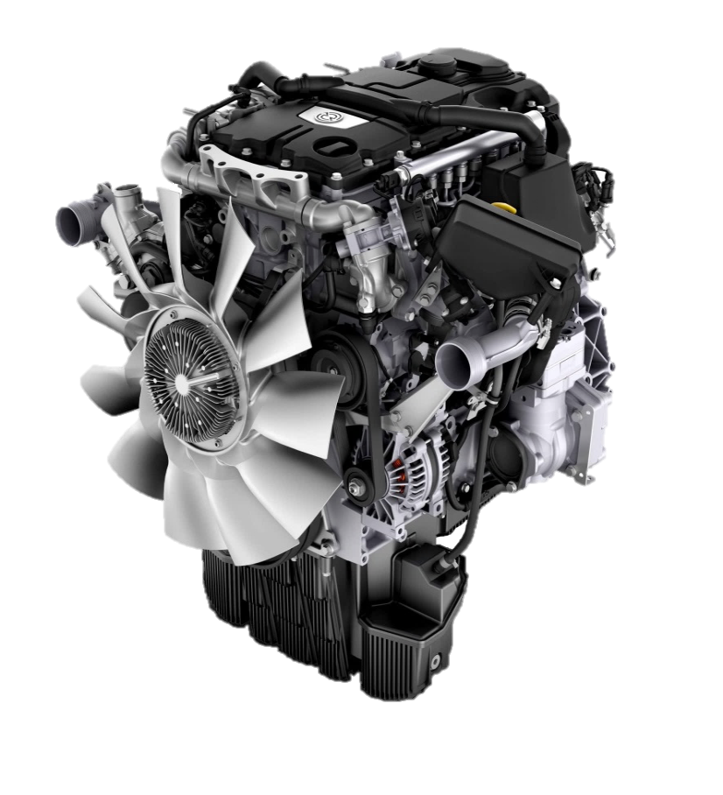
MDEG Program Scope
Global engine platform with specific market content, design and validation
Clean sheet design of single engine platform with 4 and 6 cylinder variants used to cover medium duty power ratings
Challenging program targets for improved durability, fuel economy and maintenance intervals
Platform first launched in Europe in 2013 with over 75,000 engines produced
400,000 Mile B10 Life
Notes:
Discuss Global Platform first launched in Europe. Clean Sheet design for all markets with specific development for each market and application. Engineering always challenged to provide not just another engine but a powertrain choice that provides our customers exceptional value. Base platform first launched in Europe in 2013 and our testing has shown that this is a mature platform that will benefit the program.

Slide 5
Demand Innovation
Variable Exhaust Cam phasing is used at low engine speeds to increase exhaust temperatures for effective dpf regeneration in all conditions
DOHC, piston and cylinder head all support improved combustion to support fuel efficiency and emissions compliance
Efficient regeneration of the diesel particulate filter to keep you running uninterrupted
Impressive optional integrated engine brake with up to 220 bhp available to extend service brake life
Longest scheduled maintenance intervals in its class with 45,000 miles for short-haul pick up and delivery applications

Slide 6
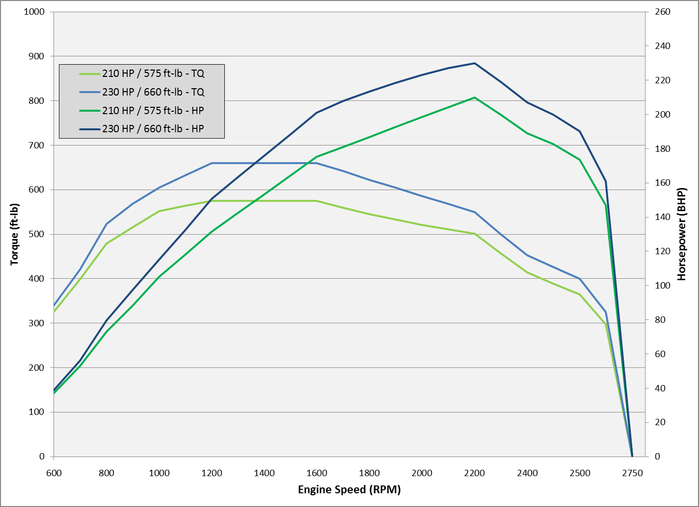
Demand Performance
DD5 Engine Power Ratings
210 HP @ 2200 RPM | 575 lb-ft @ 1400 RPM
230 HP @ 2200 RPM | 660 lb-ft @ 1400 RPM
Useable power and torque at lower engine rpm
Different power curves versus competitor
Initial launch uses 6-speed transmission
Gearing considerations specific to DD5 / don’t just assume same axle ration you use today.

Slide 7
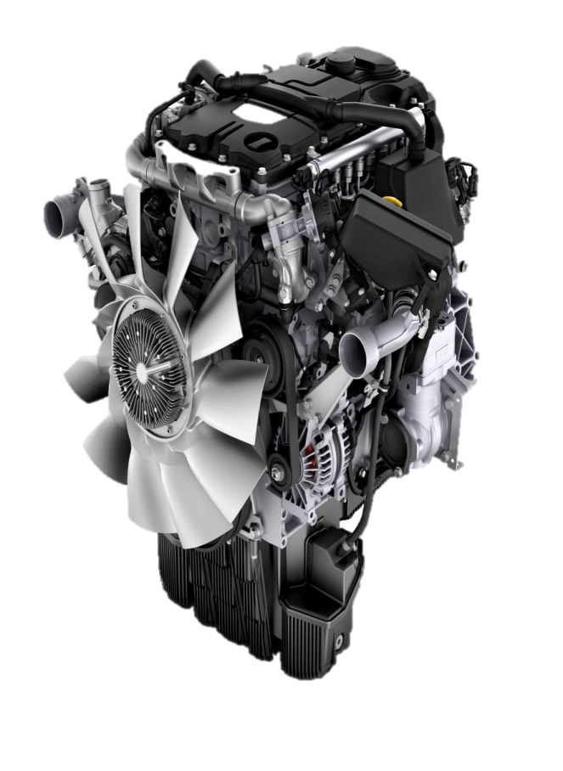
Demand Serviceability
Cartridge style fuel and oil filters mounted above rail
Maintenance free crankcase breather system
Bolt on accessories limited to 3 or 4 attachment points
Same Detroit electronic tools as used with heavy duty platform / no additional purchase required
Detroit Connect™ Virtual Technician™ remote diagnostic system

Slide 8
DD5 Maintenance Intervals
Item | Mi/Km/Hr | Severe Duty | Short-Haul | Long-Haul
Engine Oil & Filter Change* | Miles | 35,000 | 45,000 | 50,000
Fuel Filter Change | Miles | 35,000 | 45,000 | 50,000
Valve Lash Adjustment | Miles | Adjust every 90,000 or 4 years, whichever comes first
Diesel Particulate Filter | Check engine light will illuminate when ash requires removal
 | Miles | 200,000 (duty cycle dependent)
DEF Pump Filter | Replace filter every 3 years or 300,000 miles whichever comes first
$
DD5 Fuel efficiency and extended maintenance intervals = Total Cost of Ownership advantage

Slide 9
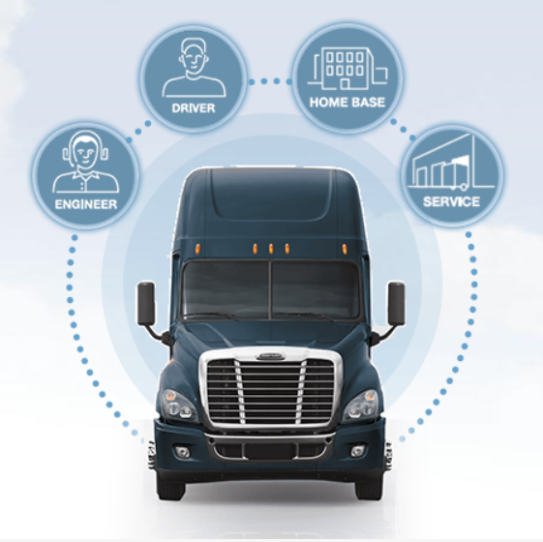
Collect Data
Analyze Data
Maximize Uptime
Lower Total Cost of Ownership

Slide 10
Telematics….What is it??
Telematics is an interdisciplinary field encompassing telecommunications, vehicular technologies, road transportation, road safety, electrical engineering and computer science. Telematics involves the technology of sending, receiving, storing and analyzing information via telecommunication devices in conjunction with affecting control on remote objects, vehicle drivers, and vehicle electronics.
Notes:
The hope for this would be a bit of an overly wordy icebreaker that builds word by word. The hope is for it to be ab a bit humorous. The next slide boils down in simple terms what “telematics” is.

Slide 11
Telematics….What is it??
It’s Actionable Vehicle Information….Delivered to you.
Notes:
On this slide we just want to show the basic concept/advantage of telematics in relation to the audience:
Audience at this event will include:
1. School Transportation Directors-the advantages of knowing in real time where buses are, how efficient they are running and how “knowledge” is power with lowering total cost of ownership.
2. Driver Trainers-with telematics, driver trainers can begin to use data collected on driver behavior (acceleration/hard stops/speed, etc.) to use in curriculuum or even for disciplinary action
3. Lead mechanics-the advantage of knowing real time fault codes and engine diagnostics to reduce downtime and ultimately lower total cost of ownership

Slide 12
Efficiency
Safety
Serviceability
Notes:
Relevance to the school bus market-
Thomas Built Buses Developed ‘BusWise” technologies that focused on three key areas:
Safety
Efficiency
Serviceability
**Only on the Saf-T-Liner C2
BusWise Audience:
Transportation Directors: “BusWise will give me better control over my fleet.”
Drivers: “Buswise will make it easier to do my job well.”
Parents: “I will have more peace of mind knowing my child is on a bus equipped with BusWise.”
Maintenance Managers: “BusWise will help me service my fleet more efficiently”

Slide 13
GHG Phase 1
Phase 1 had separate engine and vehicle standards which required 23% reduction in CO2 on vehicle and 6% reduction on engine by 2017
Phase 1 was very successful in recognizing the need to minimize test burden and forward-looking by using vehicle simulation as a component of certification
Critical to success of Phase 1 was the alignment of EPA, NHTSA, and ARB

Slide 14
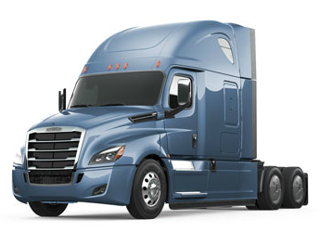
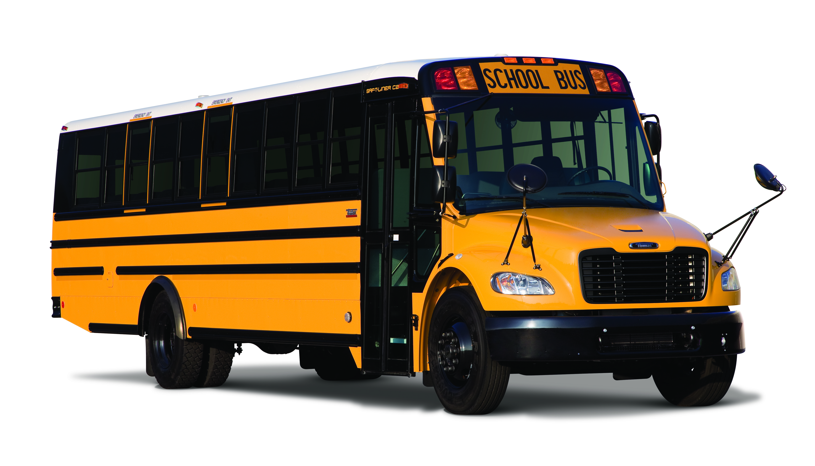
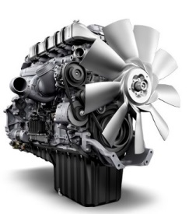
GHG2 – Challenging but Achievable
Improvement vs. GHG17
Categories
2021
2024
2027
20%
25%
Combination Tractors
13%
20%
24%
School Bus
12%
Heavy Duty
Engines*
2%
4%
5%

Slide 15
Vocational Vehicles
Specialized vocational vehicles, which cover a wide variety of heavy-duty truck and bus types. Some of these include delivery, refuse, utility, dump, cement, transit bus, shuttle bus, school bus, emergency vehicles, and recreational vehicles.
Sample of Vehicle Technologies for vocational vehicles:
Weight Reduction
Neutral-idle
Start-Stop
Automatic Engine Shutdown
2021
2024
2027
12% GHG Emission Reduction*
20% GHG Emission Reduction*
*Compared to MY2017 Standards
24% GHG Emission Reduction*

Slide 16
Thank You!

