Slide 1
Colorado

Slide 2


Slide 3
Colorado
Three Main Governing Documents
Rules for the Administration of the Public School Transportation Fund 1 CCR 301-14
Colorado Minimum Standards Governing School Transportation Vehicles 1 CCR 301-25
Colorado Operation, Maintenance and Annual Inspection of School Transportation Vehicles 1 CCR 301-26
** Colorado performs our own inspections in district, not State Patrol or CDOT**

Slide 4
New in 2016
  Resource Guide for 1 CCR 301-26 Colorado Rules for the Operation, Maintenance and Inspection of School Transportation Vehicles
  School Bus, Multifunction, and Motor Coach Operator Guide
  Type A, Multifunction, and Small Vehicle Route Operator Guide
  Type A, Multifunction, and Small Vehicle Operator Guide
  School Transportation Technicians Annual Inspection Guide
  Operators License and Training Matrix
  Streaming Online Videos – Free of cost to districts ( over 600, not all school bus related)

Slide 5
School Transportation Administrative Review (STAR)
Each district has a CDE representative go to their transportation department every 2 years at a minimum, every 4 years for approximately 16 of our largest districts, to review and determine if the district is in compliance with CDE Rules.
CDE staff alternate review procedures every 2 years – one year will be a review of garage/vehicle maintenance documentation and procedures, then 2 years following that CDE staff will review operator training, operations and driver qualification files.
Every 4 years large districts will have their entire transportation operations reviewed by both CDE staff.

Slide 6
STAR
Findings letter sent to district of commendations and/or non-compliance concerns.
District has approximately 30 days to respond in writing how they will correct non-compliant concerns.
CDE reviews letter and submitted documentation.
Send Thank You – File closed until next review
Goal is to ensure that all districts are in full compliance of
CDE/State/Federal regulations. If there isn’t any turnover in supervision and district has been in full compliance, CDE will just visit district and not perform a review, but stop and to see how we can be of assistance.

Slide 7
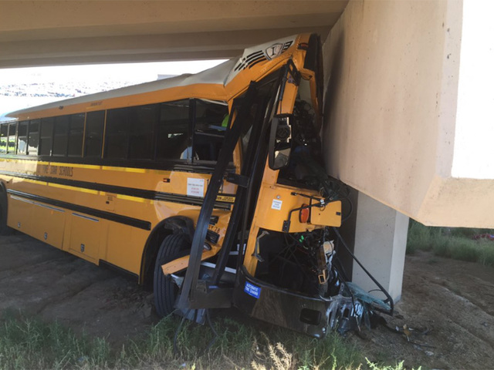
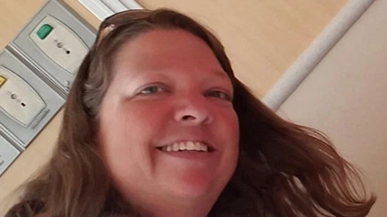
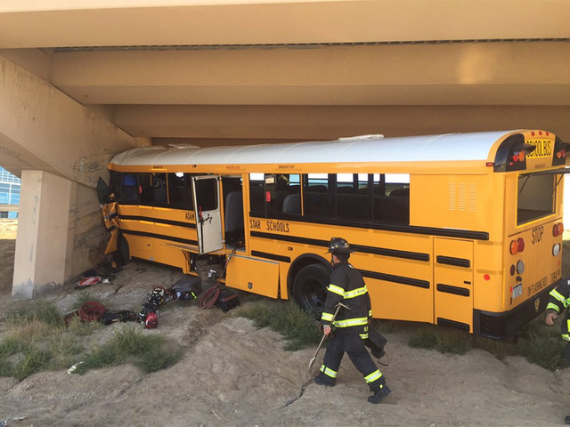
Fatal Accident
Sunday, September 11, 2016
Driver, Kari Chopper 44 years old, mother of 4 and grandmother was killed and 18 injured
Denver International Airport
https://youtu.be/bNgbfEoCg50

Slide 8
Challenges
Driver Shortage
Funding
Lack of Staff
Maintaining current communications ( emails, phone, etc.)
Local Control – Too much individual interpretation of rules and regulations/laws.
Lack of Training for District Transportation Staff (required to wear several hats, and “thrown” into the position. Offered Supervisor classes past 2 years.
Small districts – no trainers, facing new federal requirements
Lack of Third Party Testers
Geography – Plains, Mountain (Northern Slope, Front Range), Metro

Slide 9



Want to drive a bus on these roads? Come on………

Slide 10
Connecticut

Slide 11
Hawaii

Slide 12

Office of School
Facilities and
Support Services
STUDENT TRANSPORTATION SERVICES BRANCH
Director: James Kauhi

Slide 13
GENERAL FACTS
All Hawaii DOE home-school-home bussing services are outsourced to private companies
Contract terms are seven years with three one year extensions upon mutual agreement
Currently contract a total of 398 general education buses and 262 special education buses statewide to serve roughly 40,000 students in grades K-12
Since 2012, the pupil transportation program in Hawaii implemented substantial reforms in the way it procures services, contracts for services, and manages its services.

Slide 14
GENERAL FACTS
In SY 2011-12, the annual cost of pupil transportation services in Hawaii topped off at more than $72 million.
Through reform, the Hawaii DOE reduced its annual operating budget by more than $11 million over a three year span by:
  Eliminating over procurement of assets through operating efficiencies, technology
  Increasing competition within the market by utilizing the RFP vs. IFB procurement methodology; and
  Buying service TIME vs service ROUTES

Slide 15

THANK YOU!

Slide 16
Indiana

Slide 17
Office of School Transportation
Michael A. LaRocco mlarocco@doe.in.gov
(317) 232 – 0891 www.doe.in.gov/transportation

Slide 18
Indiana School Transportation Basic Statistics
Total Public Student Population - 1,046,527 public school students
Total Non-Public Student Population - 84,241 students
Transport – Approximately 65% of all public school students
Buses – 16,240
Drivers – 16,954 Certified Drivers
Funding – 100% Local Property Tax Dollars Into Two Funds:
Operations $558,964,586
Bus Replacement (12 Year Cycle) $92,490,054

Slide 19
Primary Governing Laws & Regulations
Laws - IC 20 – 27 School Transportation
School Bus Specifications - 575 IAC
  State School Bus Committee
School Bus Inspection – Sgt. Chris Kath
  Indiana State Police Inspection Manual

Slide 20
Office of School Transportation
Staff
State Director
Training Specialist – Reggie White
Support & Training Specialist – Carrie Glisson
Mandated Duties
Provide classroom training for all new school bus drivers – even if fully licensed from another state
  Approximately 1,600 drivers per year
Annual recertification of all current drivers
  Moodle
  District Led

Slide 21
Driver Licensing & Certification
Require CDL Physical
Additional State Required Physical
Physical Performance Test

Slide 22
What’s New
Effective July 1, 2016:
Ability to revoke school bus driver certification
IC 20-27-8-15

Slide 23
Iowa

Slide 24


NASDPTS
Update from the
State of Iowa
2016
NASDPTS Conference
November 7, 2016
Kansas City, Missouri
Max Christensen
State Director

Slide 25

School Transportation in Iowa…….. A Few Fast Facts
Approximately 6000 yellow school buses
Another 1500 vehicles used as “school buses”
9000 school bus drivers in Iowa
242,230 students (50% total enrollment) transported every day, twice a day
Statewide cost: $150,959,707

Slide 26

What is an average Iowa district?
Out of 338 districts in the ‘14-’15 year……..
Number of students: Enrolled - 1421 / Transported - 716
Square Miles: 165
Vehicles Per District: 22.2
Drivers Per District: 26.6
Miles Driven Per District: 168,249
Route Miles Driven Per District: 123,160
Transportation Cost Per District: $446,626 (approx 4-7 % of general budget)
Cost per student transported: $623.21
Cost per route mile: $3.63

Slide 27
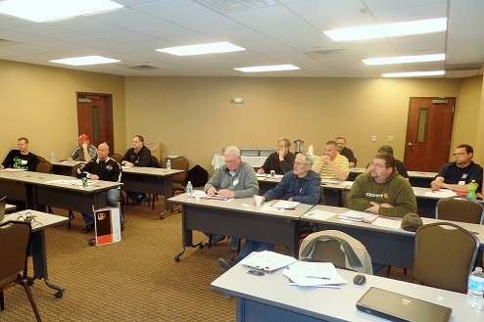
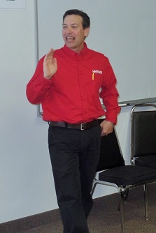
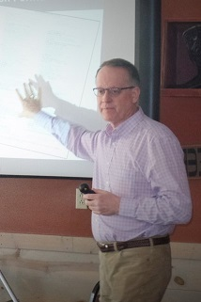
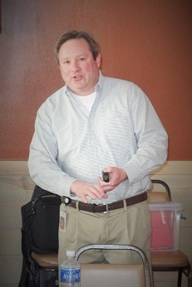
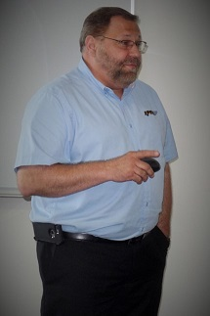
IPTA Regional Meetings – Spring 2016
Mid April
Traveled 1480 miles around Iowa
3 days per week for 3 weeks
116 attendees

Slide 28
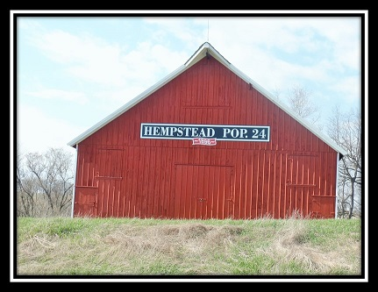
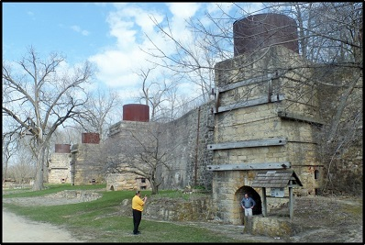
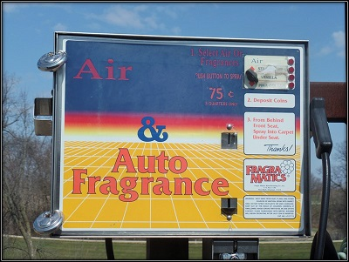

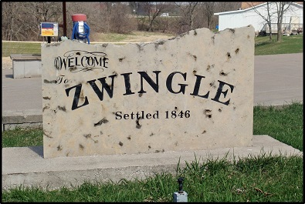
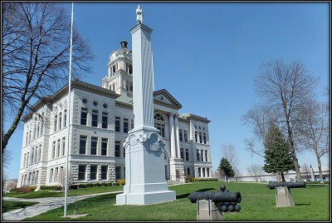
IPTA Regional Meetings – Spring 2016 - Scrapbook

Slide 29
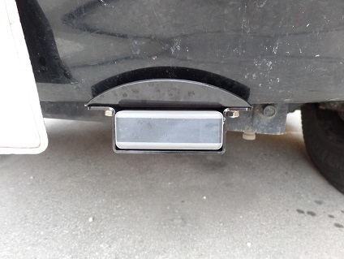
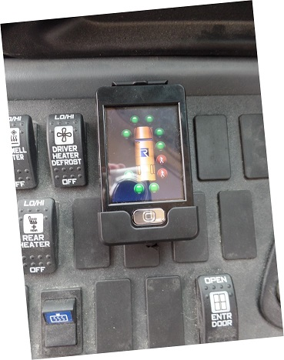
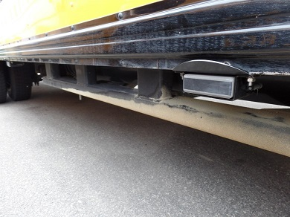
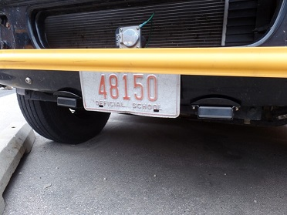

PILOT PROJECT: Student Detection System
Pilot Project in 2013
Approved for use in 2014
Company updated systems in 2016
5 schools tested – 1 currently in use

Slide 30
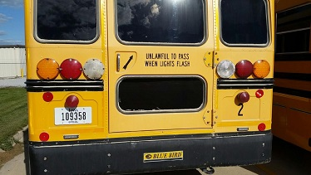
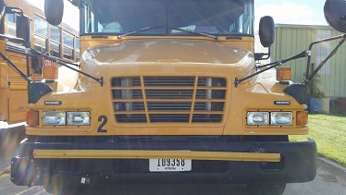
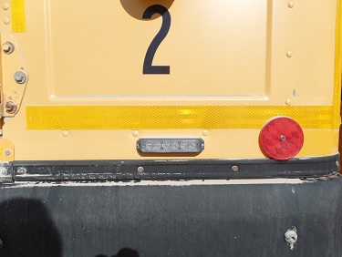
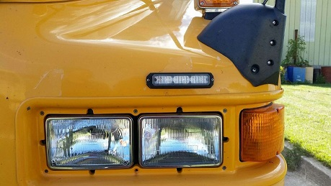
PILOT PROJECT: Supplemental Warning Lights
Tested for two years
August 2014 – July 2016
Excellent results
Approved, with many now in use

Slide 31
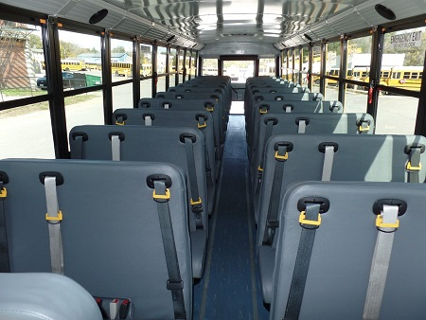
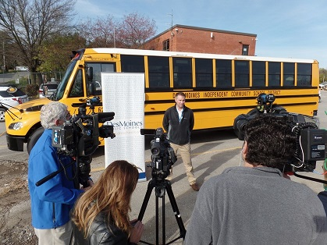
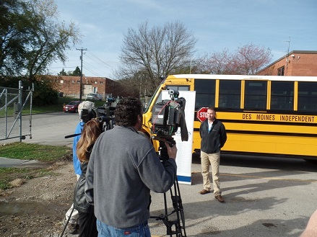
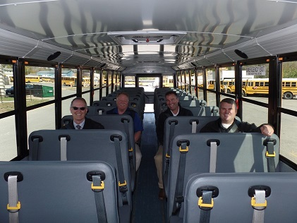
STUDY: Lap/Shoulder Belts in School Buses
Just got under way
1st bus in October / 2nd bus in December
DMPS / SynTec Seats / Thomas Bus
1 year study

Slide 32
DOCUMENT & GUIDEANCE UPDATES
Pre-Use Inspection Forms
Chassis Inspection Card
DOT Physical Form
Iowa DOT Accident Report Form
Iowa School Bus Driver Handbook (in process)
Maintenance & Inspection Manual (in process)
Chapter 44 – Minimum Standards for School Transportation Equipment (in process)

Slide 33
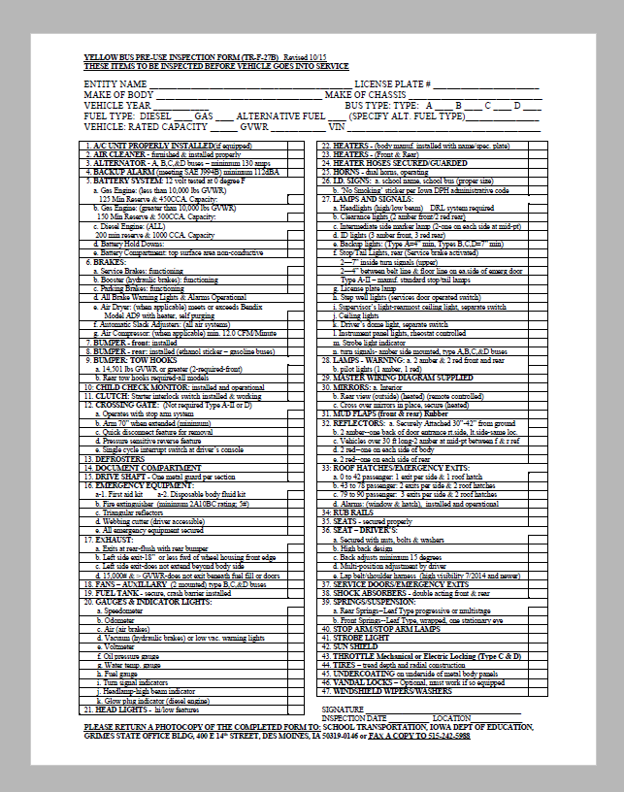
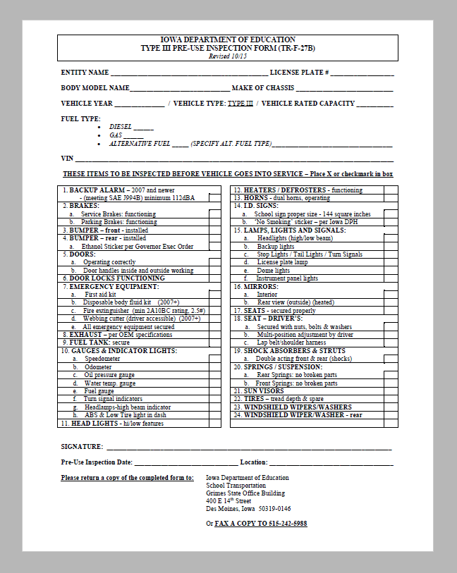
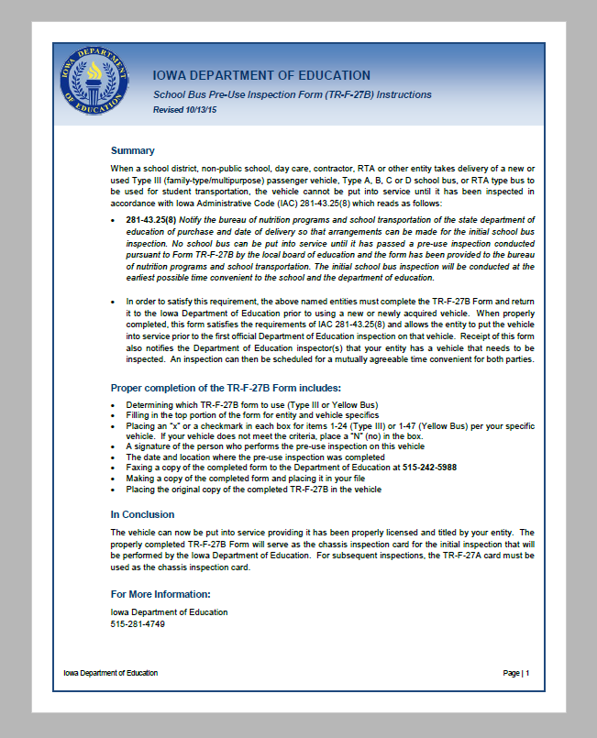
New Pre-Use Inspection Forms
DE Webpage: www.educateiowa.gov
Go to “School Transportation”
Then “Forms”

Slide 34
TR-F-27A Chassis Card
Must be done once every 12 months
Fill out completely
Carry in the vehicle
If missing, it will be a deficiency on an inspection
Obtain from the DE website
Must be dated and signed

Slide 35
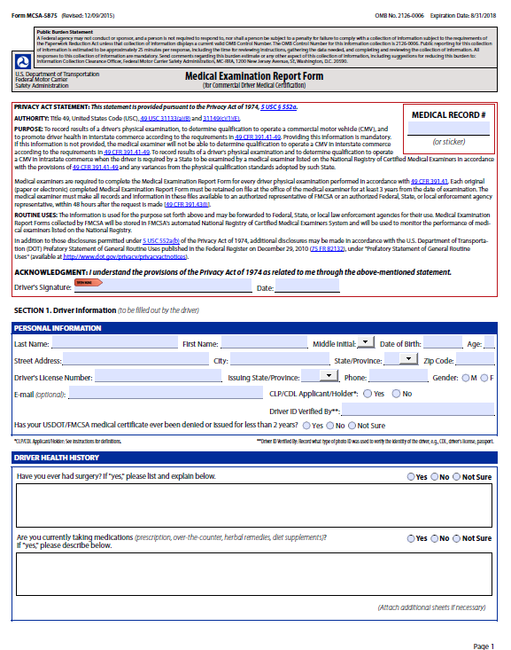
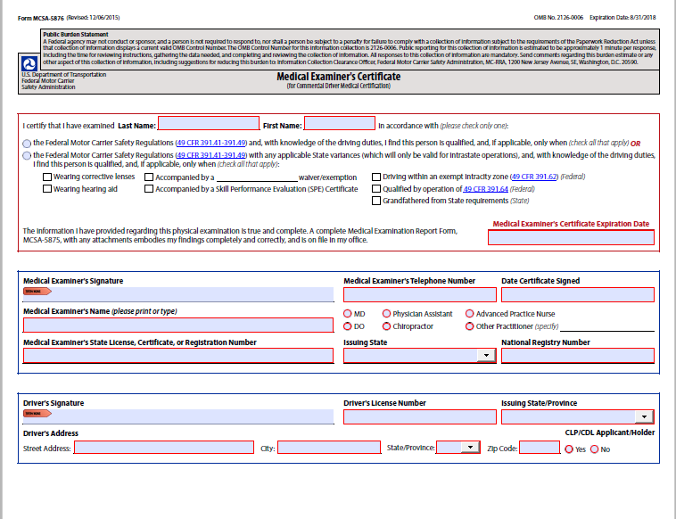
New DOT Physical Forms
…… required use by April 20, 2016

Slide 36

Accident Report Forms

Slide 37
Inspection Notification Process
The full inspection schedule is sent to every district/RTA/entity approximately 2 weeks prior to each round of inspections – Jan & July
Individual notices are sent to every district/RTA/entity the month prior to their inspection
Notice is sent to 2 people within the district for whom we have good contact information – typically the Superintendent & Business Manager
Request them to forward info to the trans director when they receive it
If the inspection is in April:
  Full inspection schedule will be sent in January
  Individual notice will be sent in March
Inspection fee is $40 per vehicle per inspection
Schedule and inspection results are always available at our website www.educateiowa.gov

Slide 38

Statewide Stop-arm Violation Survey Stats
YEAR | # STATES* | # IOWA DRIVERS & DISTRICTS | # PASSES IN IOWA | PROJECTED 100% IOWA PARTICIPATION
2011 | 28 | 2295 drivers 38% | 393 | 1034 daily 186,120 yearly
2012 | 28 | 2221 drivers 37% | 243 | 656 daily 118,080 yearly
2013 | 29 | 1596 drivers 27% | 180 | 666 daily 119,880 yearly
2014 | 29 | 1590 drivers 26% 119 districts | 198 | 761 daily 136,980 yearly
2015 | 26 | 1278 drivers 21% 92 districts | 187 | 890 daily 160,200 yearly
2016 | 33 plus DC | 1246 drivers 21% 98 districts | 165 | 786 daily 141,480 yearly
All numbers and percentages are approximations only, based on non-scientific survey results. * In association with NASDPTS (National Association of State Directors of Pupil Transportation Services)

Slide 39
TRANSPORTATION DIRECTOR TRAINING - Online
Working with the local AEA (Area Education Agency)
Will be online for transportation directors only
No requirement at this time
Will be no fee
Projected launch – late spring 2017

Slide 40
And Finally……………..
Be decisive. Right or wrong, make a decision. The road of life is paved with flat squirrels who couldn’t make a decision.
~ Anonymous

Slide 41
Kansas

Slide 42
2016 NASDPTS Conference
Kansas State Director Report
Keith Dreiling, State Director

Slide 43
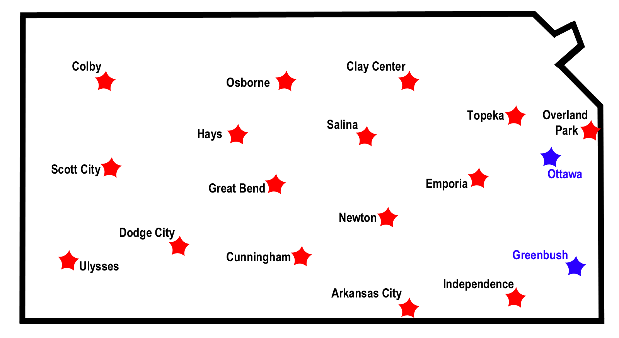
Transportation Meetings in September
Safety Review Audit Preparation
Transportation Changes, Information & Issues
Encourages networking with neighboring districts

Slide 44
New & Present Initiatives
Bus Purchasing Program
Transportation Basics Workshop for
New Transportation Directors
Mechanic Workshops
Partnering with KHP Drug Experts to offer federally
mandated reasonable suspicion training.
Moodle

Slide 45
Statistics
68,052,097 | Miles traveled transporting students
228,198 | Pre K-12 students transported daily
4,107 | CDL School Bus Route Drivers
286 | School Districts
Source KSDE 2015-16 18 E Report

Slide 46
Major Concern
School Bus Driver Recruitment and Retention

Slide 47
Thank you.
Keith Dreiling, State Director
785-296-4567
kdreiling@ksde.org
Dennis Tate, Assistant State Director
785-296-4545
dtate@ksde.org
School Bus Safety Unit
Kansas State Department of Education
900 SW Jackson Street
Topeka, Kansas 66612

Slide 48
Kentucky

Slide 49
State of Transportation From Kentucky
Elisa Hanley

Slide 50
Key Statistics
9,855 Buses as of 12/31/15
639 Certified Driver Trainers
648 Certified School Bus Inspectors
10,240 School Bus Drivers
110,264,886 Miles Travels Last School Year

Slide 51
Funding- SEEK
Funding is provided by the legislature.
The Support Education Excellence in Kentucky (SEEK) funding formula includes funds for pupil transportation to and from school
The annual tentative transportation calculation uses prior year district transportation costs and pupil density figures to determine average costs for districts of similar pupil density
Last year SEEK funded approximately 58% of the actual cost.

Slide 52
New Initiatives and Priorities
Looking for a program that will house all certifications and inspections for drivers, technicians and school buses electronically
Updating state board regulations and training manuals
Trying to reach out to local law enforcement to assist with stop arm violations
  Currently have a judge and a state representative as bus drivers

Slide 53
Bus Safety and Stop Arm Violations
45 billboards placed by Kentucky Department of Education regarding stop arm violations
School Bus Safety Pledge cards handed out to students, teachers, parents, community
Coloring Pages regarding bus safety
Overall state wide, for 2015, only 220 people were ticketed for stop arm violations
Of the 220, 107 of the tickets (47%) were dismissed.

Slide 54

Recruiting
A 10.5’ x 36’ media board with a traffic count of about 20,000 cars per day, potential exposure of about 600,000 vehicles (20,000 per day times 30 days).
First 10 days - 8 potential bus drivers enrolled the CDL class.
Went to every school in the district (15) during the Return-to-School Open Houses. Passed out 4500 recruitment flyers to interested parents during Open Houses.
Two elementary schools sent the recruitment flyer with their parent package.
Printing investment under $800.00
Parked a bus at strategic sites and attached a banner and used a pop-up shelter with school logo and made themselves available to anyone that came by.
One site included a local truck stop area just off of I-75 close to a busy CDL medical examiner’s office and another at a local grocery store on Main Street.
Driver trainer/recruiter no longer out recruiting but receiving calls from potential bus drivers.
Notes:
For $678.00-placed a 10.5’ x 36’ media board in a busy traffic location with a traffic count of about 20,000 cars per day, potential exposure of about 600,000 vehicles (20,000 per day times 30 days).
First 10 days- 8 potential bus drivers enrolled the CDL class.
Representative went to every school in the district (11 elementary, 2 middle and 2 high schools) during the Return-to-School Open Houses. Passed out 4500 recruitment flyers to interested parents during Open Houses.
Two elementary schools sent the recruitment flyer with their parent package.
Printing investment under $800.00, driver trainer/recruiter no longer out recruiting but receiving calls from potential bus drivers.
Parked a bus at strategic sites and attached a banner and used a pop-up shelter with school logo and made themselves available to anyone that came by.
One site included a local truck stop area just off of I-75 close to a busy CDL medical examiner’s office and another at a local grocery store on Main Street.

Slide 55
Minnesota

Slide 56

Lt. Brian Reu

Slide 57
MN Office of pupil transportation safety

Slide 58
2015 Annual Inspection Results
15937 Total inspection
10308 Contractor
5629 District
4020 Type III (Passenger Vehicles under 10,000 LBS GVWR)
1650 A’s
4 B’s
8741 C’s
1522 D’s
1921 Randoms (events, schools, garages)
  203 were placed out-of-service

Slide 59
2015 Private vs. Public
Annual Inspection Info | Private | Public
Percent of total | 64.7% | 35.3%
Passing Rate | 88.3% | 88.3%
Temp Rate | 4.3% | 4.6%
Fail Rate | 7.4% | 7.1%

Slide 60
AGENCY INVOLVEMENT WITH INDUSTRY
Monthly School Bus Safety Committee meetings
School Bus Stakeholders group- Meets 3 times a year
Winter Conference
Spring Regional Outreach Presentations
MN School Bus Road-eo
MSBOA Summer Conference
MAPT Train the Trainer (Summer Conference)
School Bus Safety Poster Contest – MN Twin’s Game recognition.
School bus driver outreach presentations
  69 presentations Aug-Sept
Legislative Initiatives

Slide 61
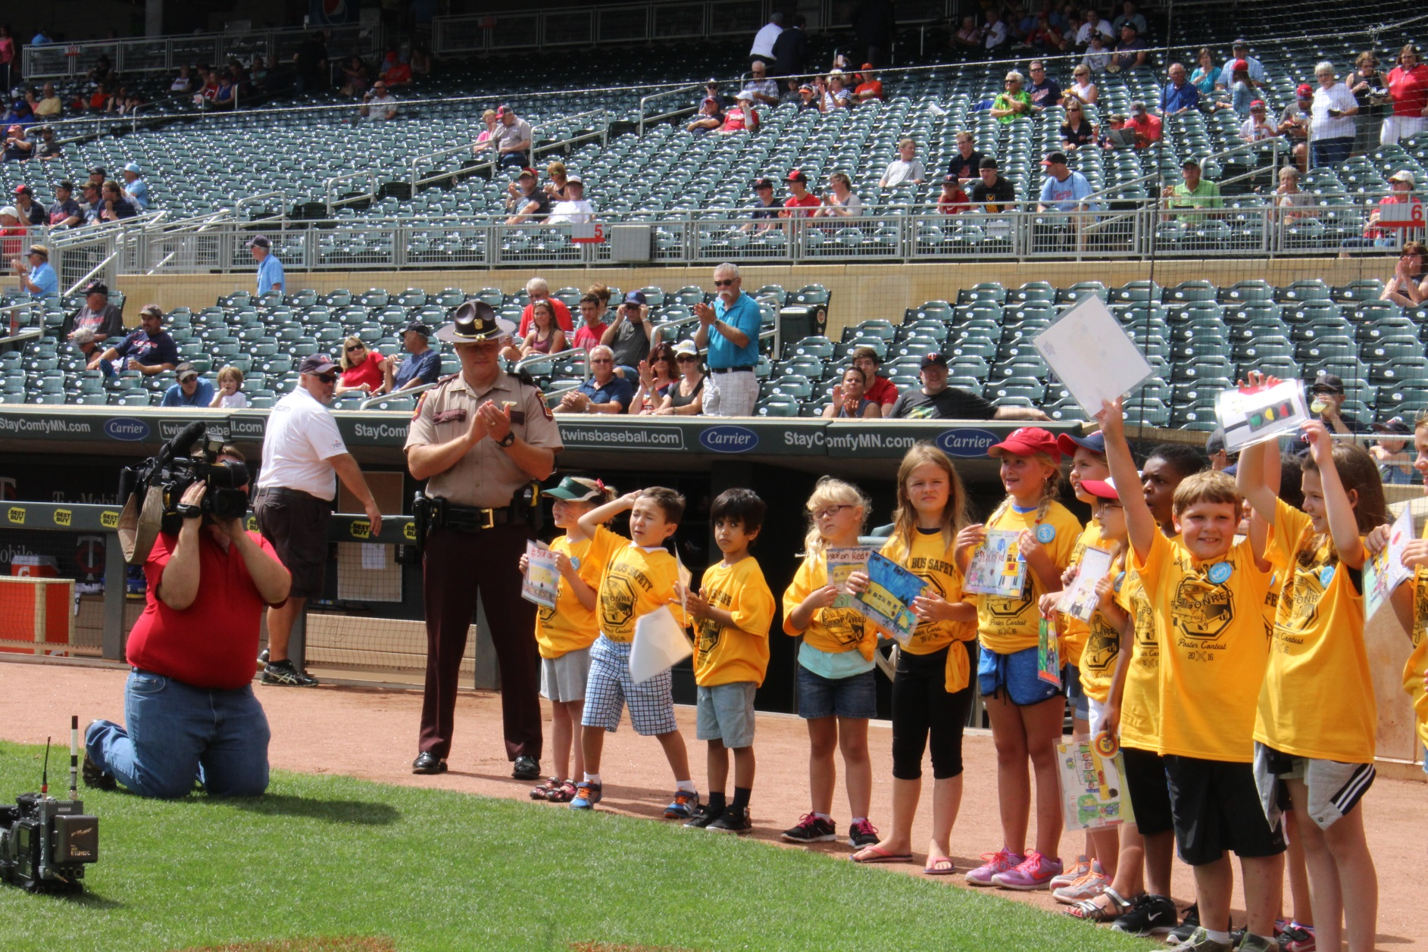
Student Recognition

Slide 62
Missouri

Slide 63

Missouri
State of Transportation
Missouri Department of Elementary
and Secondary Education
November 2016

Slide 64
Missouri Public School Stats
2015-16 School Year/2016-17 Payment Year
Students Transported Daily: 543,550
Route Miles Traveled: 107,354,628
Non-Route Miles Traveled: 22,011,086
Total Costs: $484,423,023
Total School Buses: 12,014
36% contracted, 64% district-operated

Slide 65
School Transportation Funding Shortfall
Entitlement (75% of Route Costs): $272,222,271
Reimbursement:
  Appropriated: $105,297,713
  Current Funding Available: $86,780,987
State Law Funding Reimbursement: 75%
Current Funding Level: 30%
Funding in 1999-2000: 99.5%
Highest Appropriation: $167,797,713 in 2007-08 with 68.7%
Average increase in costs: 4%

Slide 66
Missouri School Bus Specs Revised
Technical Advisory Committee meet in May 2016, reviewing the 2015 National School Transportation Specifications compared to the current 2013 Missouri Minimum Standards for School Buses
The Missouri Minimum Standards went to the State Board of Education for approved as a proposed rule in October 2016
Rulemaking process will take about 6-7 months.
New Minimum Standards will take effect for school buses manufactured after June 30, 2017

Slide 67
School Bus Driver Shortage
Many Missouri school districts are fighting a school bus driver shortage
  Part-time/split shift job
  Increased number of transportation routes
  No benefits
  Low pay
  Complexity of pre-trip CDL test
  CDL 14 day permit requirement

Slide 68
Contact Information
Debra Clink
Manager, Student Transportation
Missouri Department of Elementary and Secondary Education
(573) 751-0357
Debra.Clink@dese.mo.gov
dese.mo.gov | facebook.com/MOEducation
twitter.com/MOEducation | youtube.com/MODeptofEducation

Slide 69
North Carolina

Slide 70

North Carolina Update
Derek Graham, Section Chief
Transportation Services
North Carolina Department of Public Instruction

Slide 71
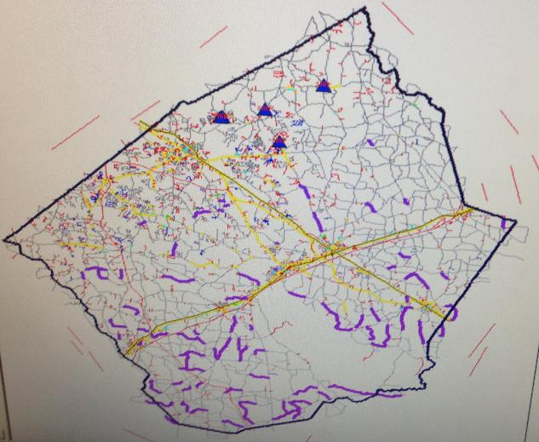
A Primer on Re-Routing by Hurricane Matthew
“Purple Worms” – ROAD OUT

Slide 72
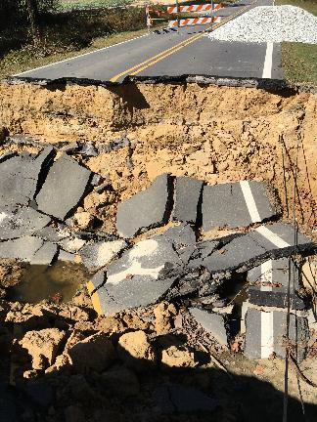
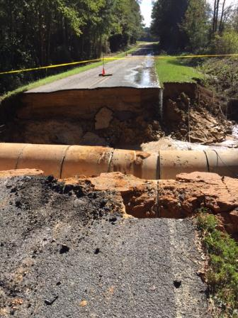
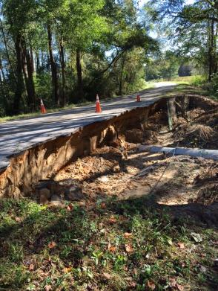

Slide 73
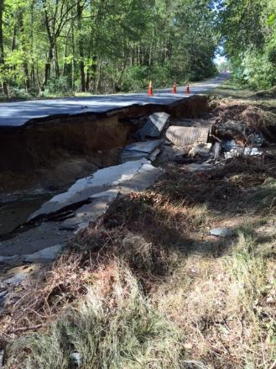
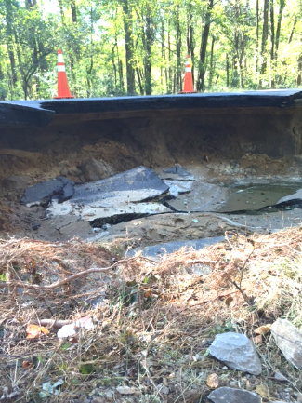
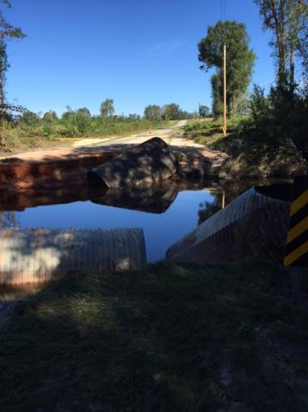

Slide 74
Lap Shoulder Belts
In NC, school buses are replaced at state expense after 20 years, 200k miles
  (about 600 for 2015-2016)
11 districts chose the lap/shoulder belt option – 82 buses total – included at state expense, all within budget for the 600 buses

Slide 75
Lap Shoulder Belts
District had to agree to implement a mandatory use policy
Initial reports from most districts – implementation easier for elementary, but some success with older students
Change has its challenges

Slide 76
North Carolina Update
Derek Graham, Section Chief
Transportation Services
North Carolina Department of Public Instruction

Slide 77
North Dakota

Slide 78
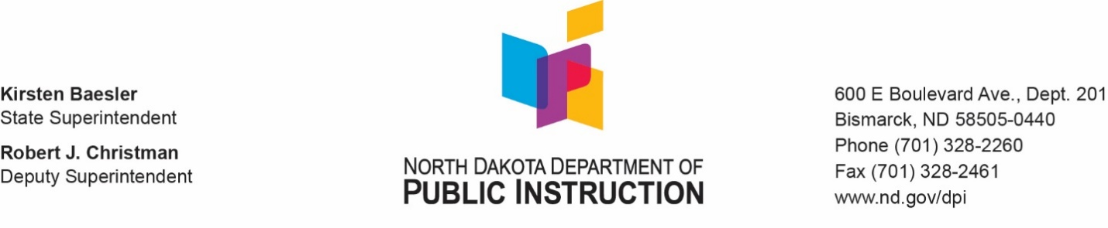
ND State Director’s Report
November 2016
Don Williams

Slide 79

Current Issues
  Working with NDDOT for Railroad Crossing improvements
  Running a press release on the increasing number of Stop-Arm violations for two of western area, large school districts. Possible PSA in the near future.

Slide 80
Funding (highlights)
  Transportation Grant appropriated by Legislation every 2 years
  One dollar and eighteen cents ($1.18) per mile for school buses having a capacity of ten or more passengers;
  Fifty-five cents (.55) per mile for vehicles having a capacity of nine or fewer passengers
  Fifty-four cents (.54) per mile, home-to-school/route (one way, rural)
  Thirty-two cents (.32) per mile (one way, in-city)

Slide 81
Reimbursement Cap includes Actual operating transportation expenditures, an 8 year average of transportation equipment, and a percentage of Administration and Overhead expenses

Slide 82

Questions

Slide 83
Oregon

Slide 84
Oregon
ODE responsible for transportation of students regardless of method
  School buses, white activity buses, vans/passenger cars
272,121 kids (47%) and 64,673,606 miles
Transportation Mandated, funding through State School Fund
Key initiatives:
  Rule updates
  Review district audit procedures
  Supervisor Certification
  Building a training library for ECUs
Notes:
About 6800 school buses, 7700 total vehicles
About 6400 school bus drivers, 8300 activity drivers
Talk about funding
Rule update, how we track contracted type 10 service.
Talk about inspection program and Supervisor Cert and need for training library at ODE.

Slide 85
Washington

Slide 86


STATE OF THE BUS
Glenn Gorton
Director of Student Transportation – OSPI
NASDPTS 2016

Slide 87
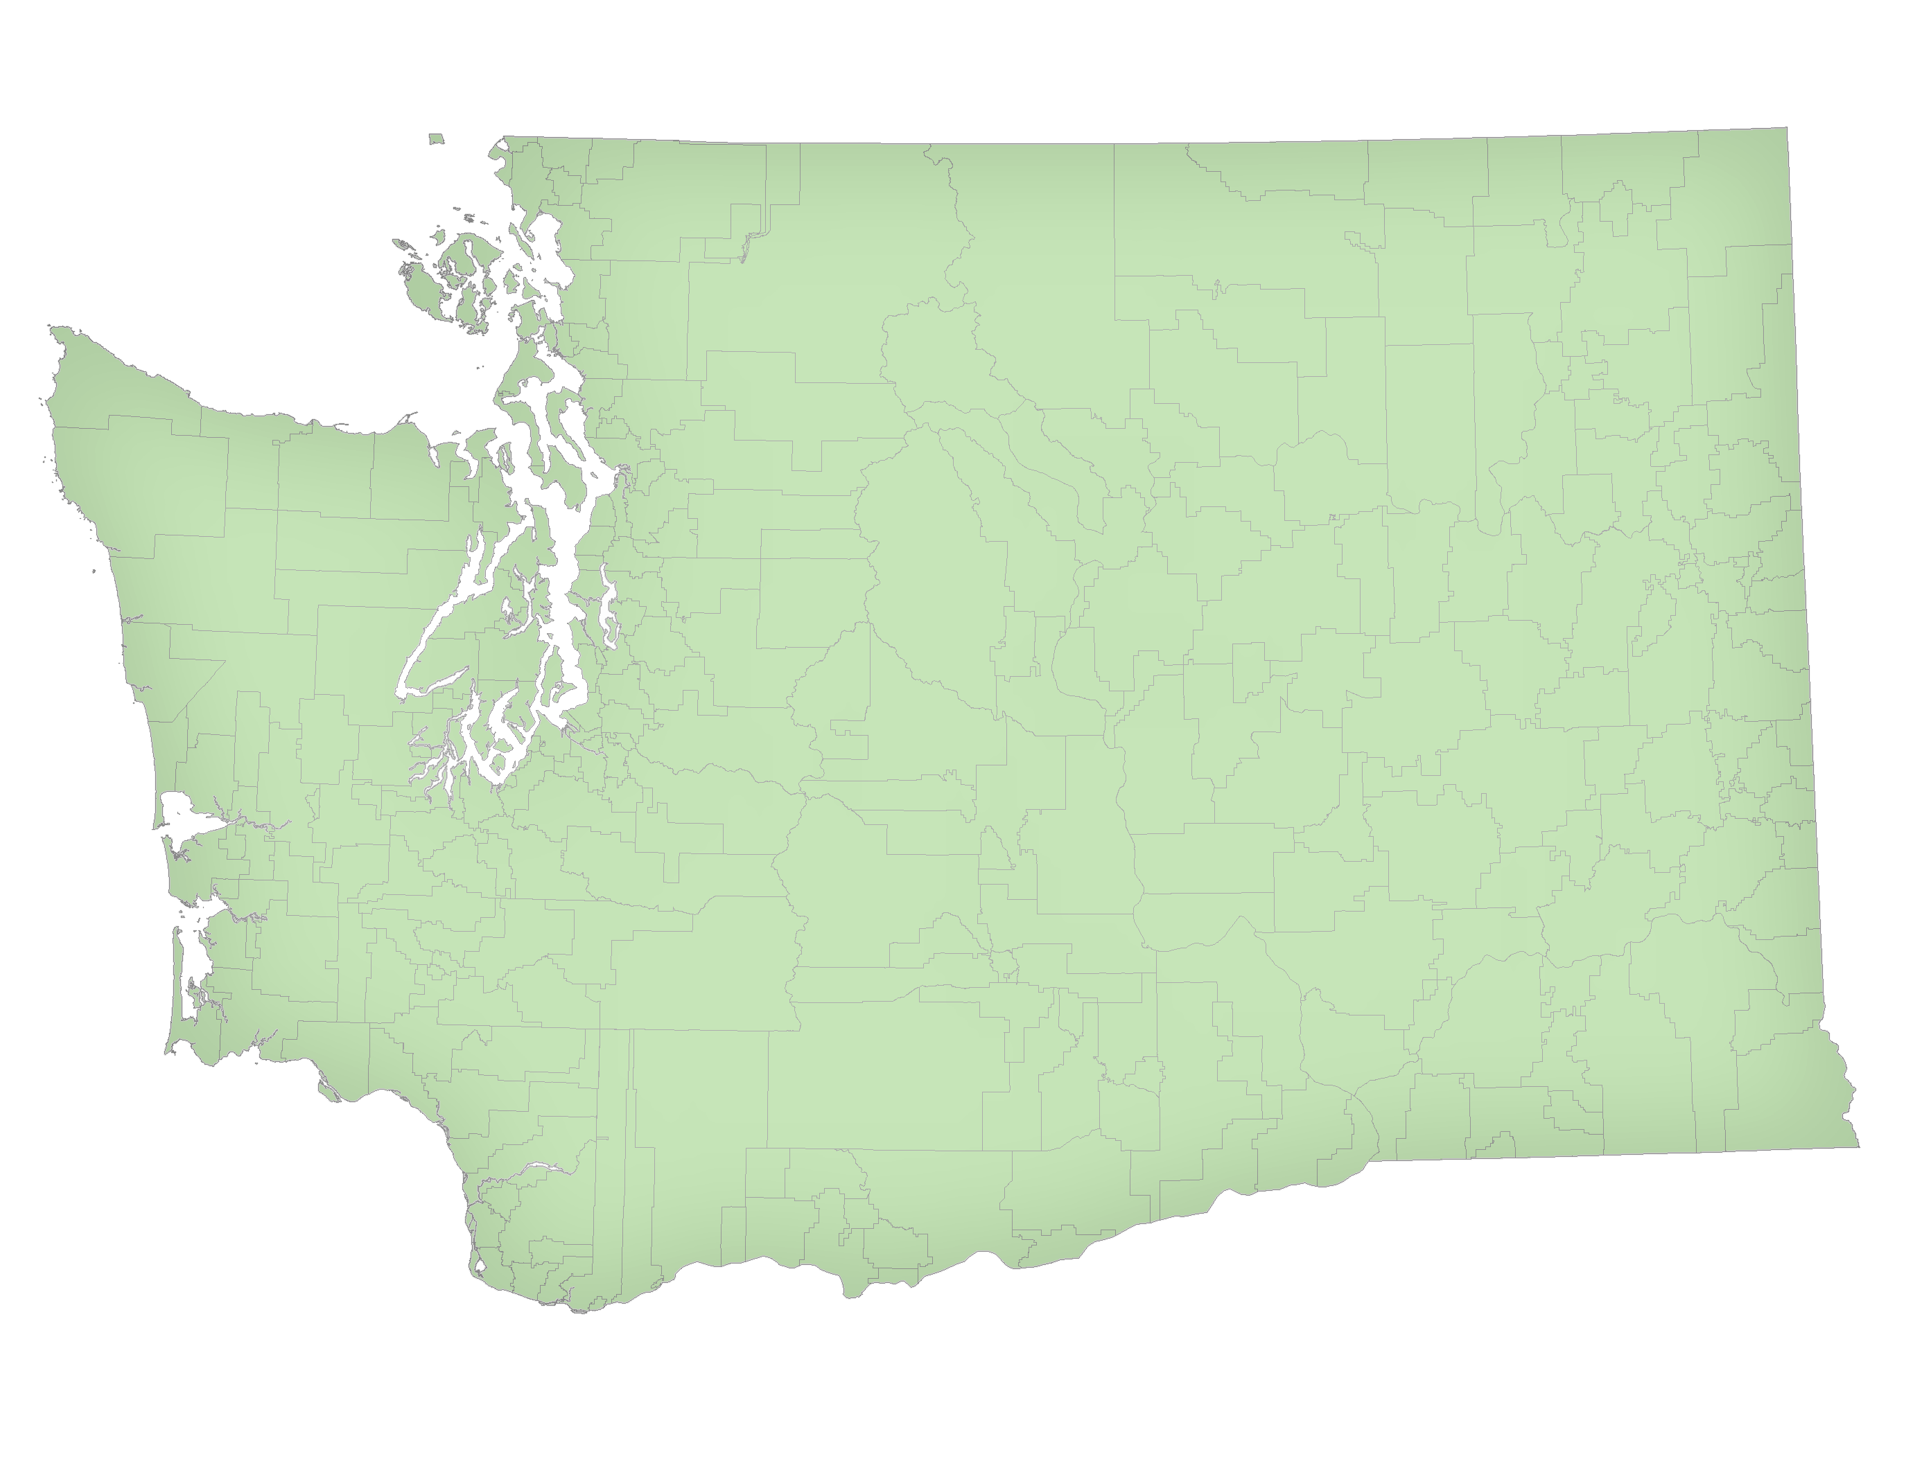
School Districts
295 districts
8 Charter Schools
4 Compact Schools (tribal)

Slide 88
Operations – Regression Formula
Previous year expenditures
Land area
Average distance
Destinations
Basic program counts
Special program counts

Slide 89
Operations
Total Previous Year Expenditures: $441,347,696.75
Actual Reimbursement: $421,055,016.97

Slide 90
Buses
10,450 State wide
A and B buses - 8 Years
C and D buses - 13 Years
$52,244,000 District Buses (Replacement Cost)
$720,000 Contractor Buses (Depreciation Cost)

Slide 91
Wisconsin

Slide 92
Wisconsin Transportation
District responsibility - required 2 miles or more – or hazard area
State categorical aid based on miles transported/student
  $15/under 2mi; $35/2-5mi; $55/5-8mi; $110/8-12mi; $300/12+mi
Adjusted 2014-15 transportation cost = $ 357,886,579
2015-16 Aid
  All aid is spent out – based on percent of formula total
High Cost Transportation Aid – 128 of 422 districts
  < 150% average cost/student; > 50 students/sq.mi. - $7.5 M
Equalization aid supports general costs – average 62%

Slide 93
Wyoming

Slide 94

Wyoming Update
Stop Arm cameras mandated on every school bus commencing with the 2016-17 school year.
Built convertible school bus seats into the Fall 2016 Bus Bid as a standard spec moving forward.

