Slide 1
NASDPTS Executive Director’s Report
NASDPTS Annual Conference
Charlie Hood, NASDPTS Executive Director
November 9, 2016

Slide 2
Thinking Outside the Bus
Loading zone safety remains a “needs improvement” area
NASDPTS taking a more active role in assisting Kansas DOE with its annual survey
NASDPTS will continue its annual survey of illegal passing of school buses.
NHTSA meeting December 1 will focus on ways to improve loading/unloading safety

Slide 3
NHTSA Meeting December 1, 2016
Invited parties include NASDPTS, NAPT, NSTA.
Participants from SBMTC and PTSI also recommended to NHTSA
Priority topics not finalized, but expected to include strategies for:
Reducing distracted driving
Eliminating student dragging incidents
Improving safety outside the bus
Preventing illegal passing

Slide 4
NTSB Recommendations
NASDPTS will respond to NTSB recommendations prompted by 2014 Anaheim, CA school bus crash
Recommendations were sent to NASDPTS, November 7, 2016, concurrent with presentation to our members by Chris Hart and release of the new NTSB school bus safety video

Slide 5
NTSB Recommendations, 11/7/16
To NASDPTS, NSTA, and NAPT:
H-16-7-- Inform school bus drivers of the impact their health may have on the safe transportation of school children, of their responsibility to accurately and completely report their health history and medications, and of the legal consequences of dishonesty on the medical examination report.

Slide 6
NTSB Recommendations, 11/7/16
H-15-2-- Encourage your members to ensure that any onboard video system in their vehicles provides visibility of the driver and of each occupant seating location, visibility forward of the vehicle, optimized frame rate, and low-light recording capability.

Slide 7
NTSB Recommendations, 11/7/16
H-13-36-- Provide your members with educational materials on lap and shoulder belts providing the highest level of protection for school bus passengers, and advise states or school districts to consider this added safety benefit when purchasing seat belt-equipped school buses.

Slide 8
Eligibility and Funding Survey*
Survey sent out October, 2016
35 states have responded to date
Students eligible for legally required transportation in 29 states; not required in 6
Distance for primary students:
1.0 mile, 9 states
1.5 mile, 6 states
2.0 miles or more, 10 states
*preliminary data

Slide 9
Eligibility and Funding Survey*
Distance for middle school students:
1.0 mile, 3 states
1.5 mile, 8 states
2.0 miles or more, 12 states
Distance for high school students:
1.0 mile, 3 states
1.5 mile, 7 states
2.0 miles or more, 11 states
*preliminary data

Slide 10
Eligibility and Funding Survey*
Nearly all states provide or allow transportation for IDEA and McKinney through LEA operated buses, contracted transportation, and public transit
Only two states provide NO level of state funding for student transportation
Proportion of cost reimbursed by states ranges from 18 to 100 percent
Nearly all distribute state dollars based on a state formula
*preliminary data

Slide 11
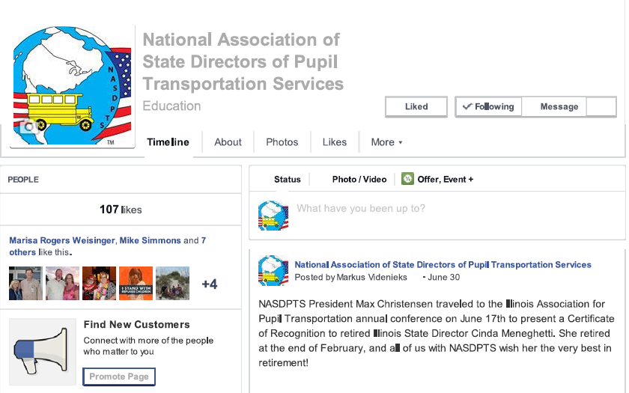
Staying connected
www.NASDPTS.org
www.facebook.com/nasdpts
https://twitter.com/nasdpts (@NASDPTS)

