Slide 1
Moving Toward Zero—
Reducing Illegal Passing of School Buses
Charlie Hood, Executive Director, NASDPTS
Mike Martin, Executive Director, NAPT
Ronna Weber, Executive Director, NSTA
December 1, 2016

Slide 2
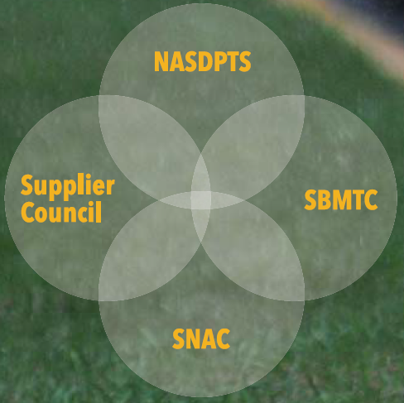

National Association of State Directors of Pupil Transportation Services
Provides leadership, assistance, and service to the nation’s student transportation community
Membership includes state directors, state associations, suppliers (bus OEMs, component and service providers), and others
School Bus Manufacturers Technical Council provides technical expertise from large and small bus OEMs

Slide 3
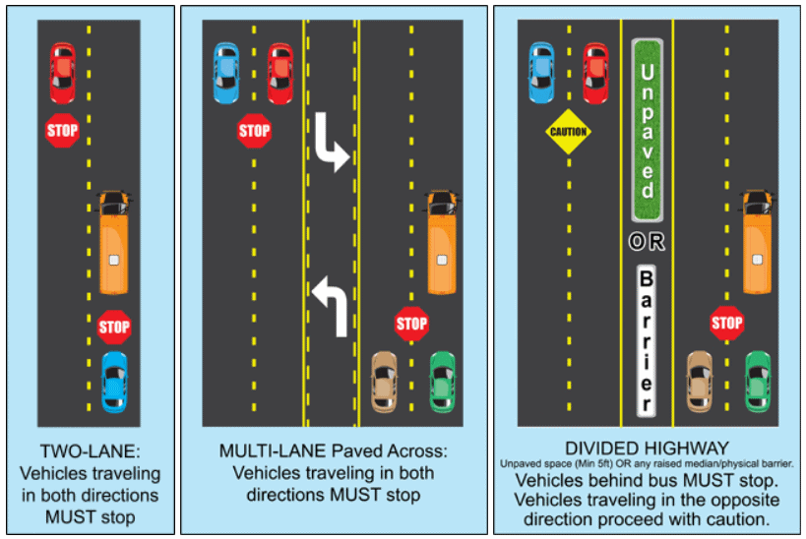
Illegal Passing—the Big Picture
Why is reducing illegal passing a priority?
How prevalent is it?
What are the dangers?
What are the contributing causes?
What are some safety countermeasures?
Who are the safety partners?
How can we move toward zero?

Slide 4
Quantifying the Obvious
In 2010 NASDPTS conferees adopted a resolution establishing the first Stop Arm Violation Survey
Goal was to quantify anecdotal evidence that motorists were frequently passing stopped school buses illegally
National survey was to expand on prior state surveys (e.g., Florida and North Carolina)
States instructed to have drivers report illegal passing incidents during a one-day “snapshot” in the spring
NASDPTS established the standard reporting form and procedures
Data collected was intentionally minimal--drivers were cautioned that attention to safety of students during loading and unloading was priority number one

Slide 5
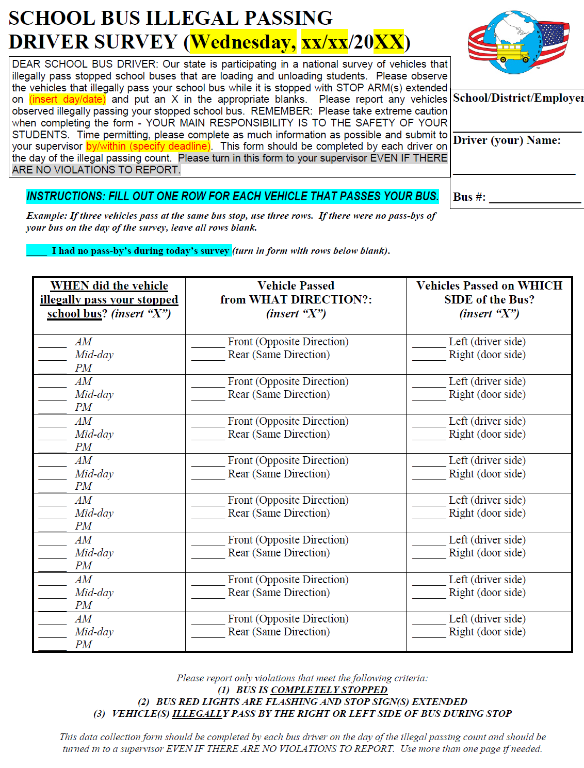

Slide 6

NASDPTS Illegal Passing Survey
Completed annually since 2011 to document incidence of this well known safety threat
2016 survey results:
  96K school bus drivers in 33 states, plus DC, participated
  74K motorists illegally passed stopped buses
Complete results available at http://www.nasdpts.org/StopArm/index.html

Slide 7

Multi-year Summary

Slide 8
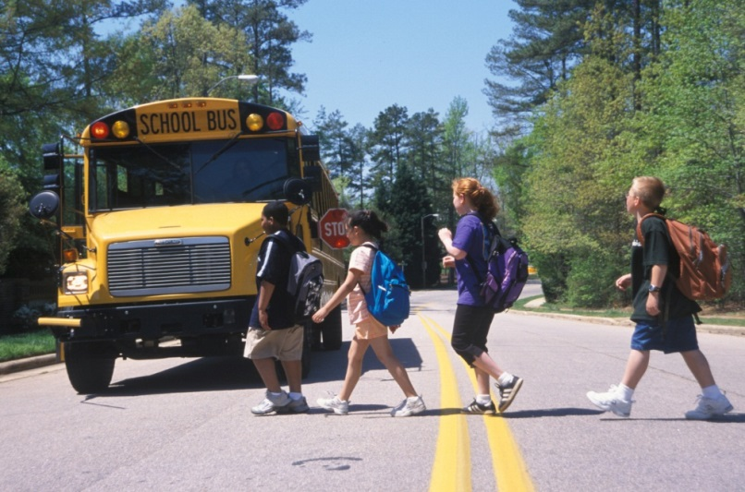
Survey Takeaways
Results unfortunately consistent over six years
About 20 percent of the nation’s school bus drivers participate
Just over half of states participate
AM and PM passes about equal
About 58% of passes from front, 42% from rear
Equates to over 13M per year
2% are on right side!

Slide 9
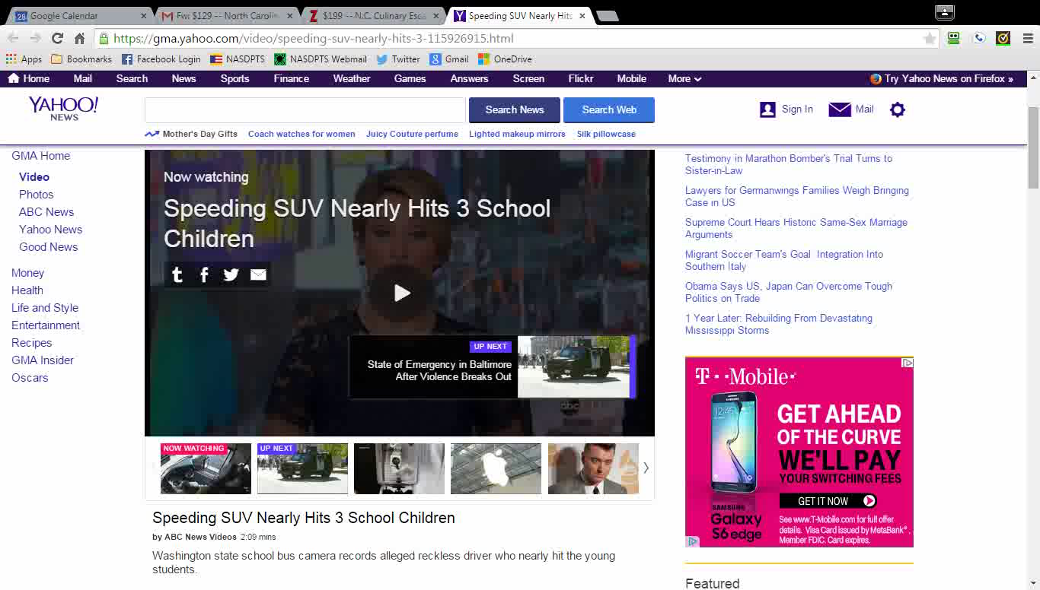
Right Side – Washington State

Slide 10
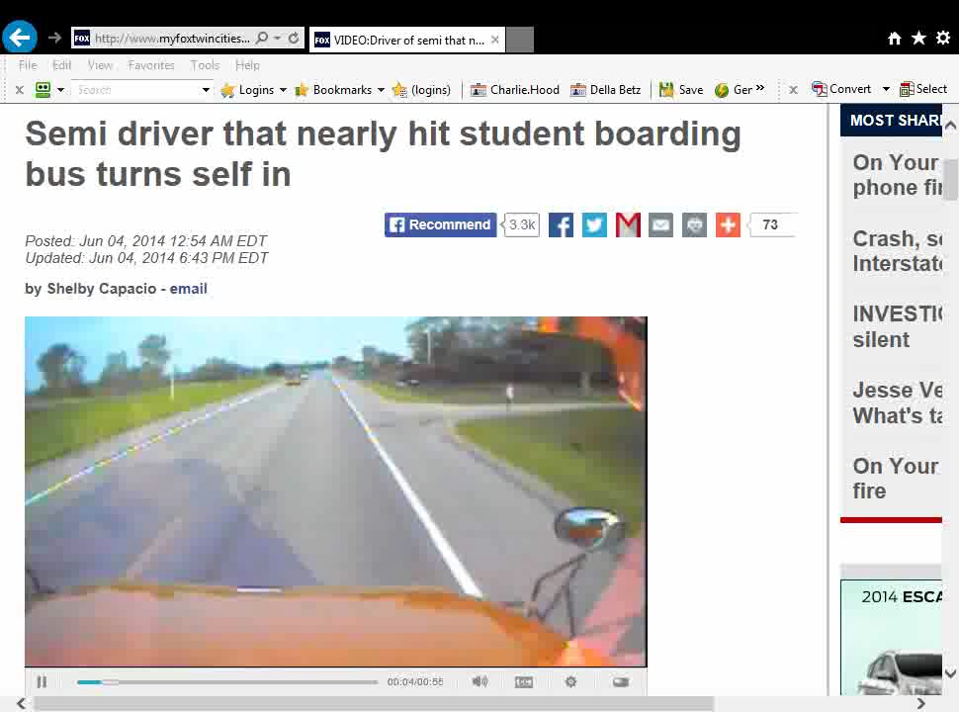

Slide 11

Student Loading Zone Fatalities
Kansas has conducted annual surveys of all states since 1970
During past five years (FY2011 through FY 2015), nationally:
  Average of five students per year killed by vehicle illegally passing school bus
  Average of three students per year killed by own bus
  http://www.ksde.org/Agency/Fiscal-and-Administrative-Services/School-Finance/School-Bus-Safety/Loading-and-Unloading-Surveys

Slide 12
Kansas Survey 45-year Trends
65% of fatalities PM; 32% AM
66% of fatalities were children 8 years old or younger
Most fatalities in daylight, clear weather
No significant difference in boys vs. girls killed
No significant difference in day of week (M-F)

Slide 13
Survey of State Laws
In 2013 NASDPTS conducted survey on state laws requiring motorists to stop for school buses
37 states responded
All states required motorists to stop from both directions on two lane roads
For roads of 3 or more lanes, all required motorists to stop when approaching from rear
Most states allow motorists opposing bus to proceed if there is an unpaved median
In 26 states law enforcement MUST witness violation to secure a criminal penalty
17 states allow photo/video evidence
Significant variations in laws, consequences

Slide 14
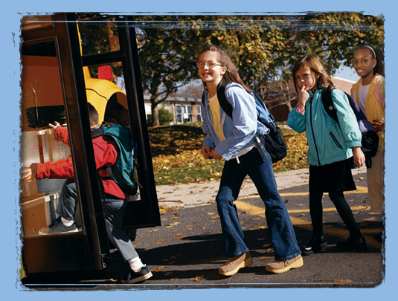
Loading Zone Safety
Yellow school bus transportation remains far safer than other modes
For example, less than one percent of youth fatalities during school travel hours are in school buses, versus 57 percent when riding with teen drivers and 23 percent with adult drivers (www.schoolbusfacts.com)
Loading zone safety remains our priority
Required safety countermeasures are a complex mix of laws, policies, and best practices that include…

Slide 15
Safety Countermeasures
Prevention of stop arm violations through public awareness and enforcement
Student rider training
School bus driver training in crossing and student signaling procedures
Vehicle factors (mirrors, high visibility lighting, pupil crossing arms, conspicuity)
School bus stop placement
State laws and penalties for violations

Slide 16
Safety Countermeasures
Documenting the problem:
  Illegal passing surveys
  Identification of high violation areas
  Video or photo recording of violations
  Notification of high violation areas to public and law enforcement
Public awareness efforts:
  State law on required motorist actions when encountering buses slowing or stopped
  Back to school safety messaging
  Discussion of consequences (not just civil or criminal penalties)

Slide 17
Safety Countermeasures
Enforcement:
  Ongoing relationship with local and state police
  Training and awareness for prosecutors and judiciary
  Priority on most vulnerable locations
  Ongoing enforcement and enforcement blitzes
  Police presence emphasis during back to school, Safety Week, Love the Bus
  Citations from photo or video evidence (if legal)
  Longitudinal tracking of enforcement frequency
Student rider training on bus stop waiting location, potential hazards, crossing procedures
Driver training in stopping sequence, student crossing, and student signaling procedures

Slide 18
Gaps and Data Needs
National data is needed on:
  State laws re: stopping for buses
  State and local enforcement levels
  Related student injuries
  State regs and training of drivers and students (e.g., crossing procedures)
  Effectiveness of countermeasures (e.g., photo/video enforcement)
  Further analysis of Kansas and/or FARS data

Slide 19
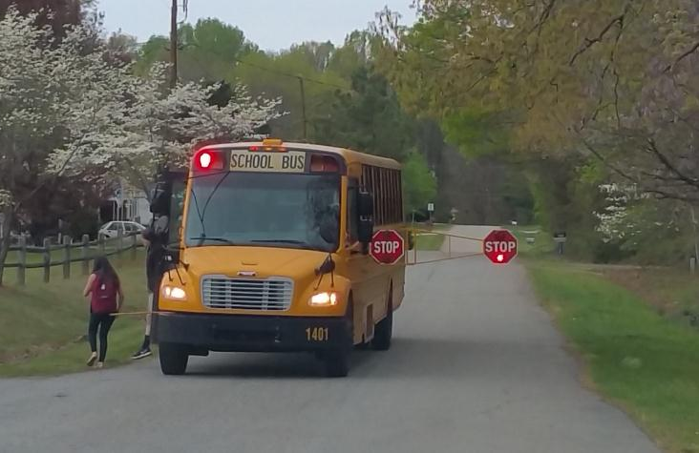
Model Policies, Best Practices
  For discussion, is there need for?:
    Model state law re: stopping for buses
    National priority on illegal passing enforcement (e.g., targeted grants)
    Model training curricula for school bus drivers and student riders
    Model state law on photo/video enforcement
    Promoting loading safety-related vehicle specifications and operational procedures of National Congress on School Transportation (ncstonline.org)

Slide 20


Slide 21
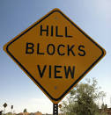
Contact Info
ExecDir@nasdpts.org (Charlie Hood)
850-274-4308
www.nasdpts.org

Slide 22
Contact Info
Mike.Martin@napt.org
800-989-NAPT (6278)
www.NAPT.org
rweber@yellowbuses.org (Ronna Weber)
703-684-3200
www.yellowbuses.org (NSTA)

